Slide 1
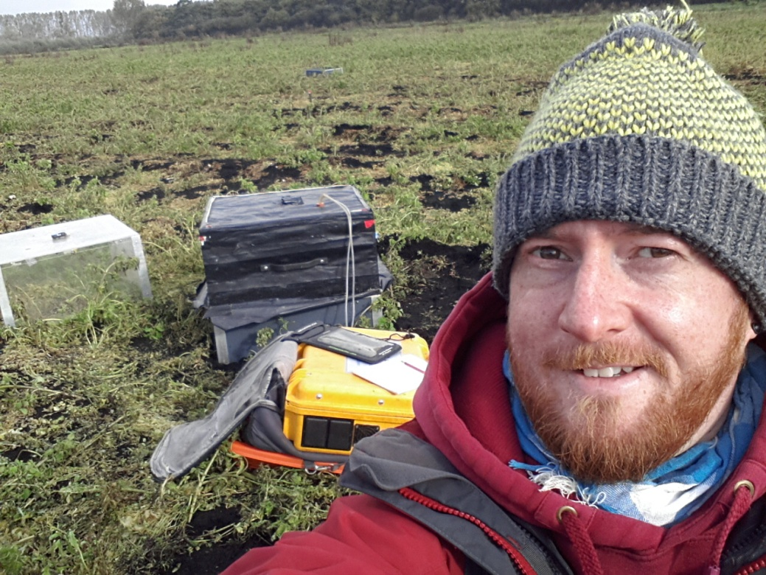
Dr Luke Ridley
Head of water quality research,
Defra
Ventura Showcase – 24th April 24

Slide 2
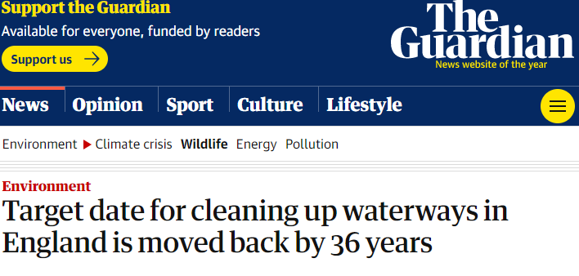
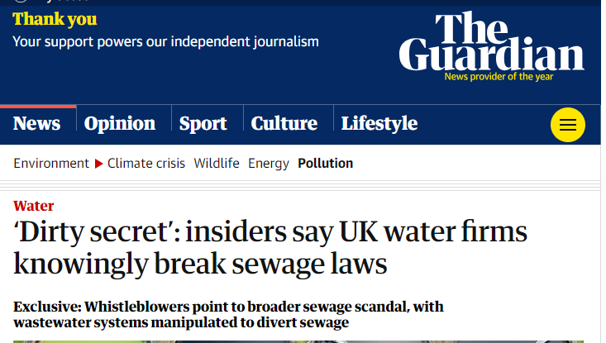
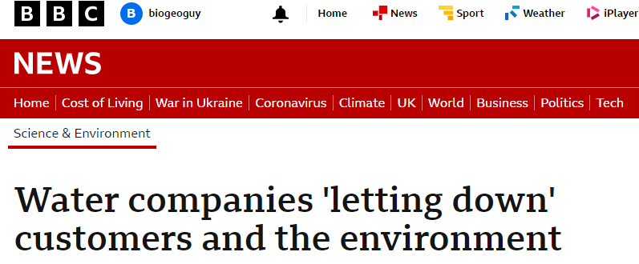
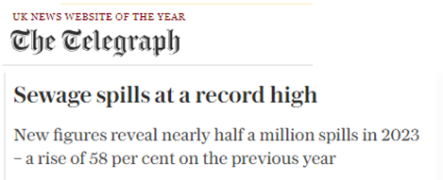
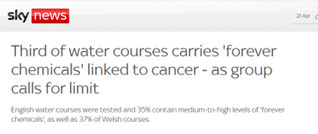
Water in the news

Slide 3
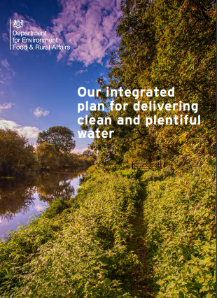
Defra is doing a lot on water!
2018 – published the 25 Year Environment Plan
2021 – Environment Act
2022 – Four long term (15 year) water targets
2022 – Storm Overflows Reduction Plan
2023 – Environmental Improvement Plan
2023 – Integrated Plan for Water

Slide 4
Defra is doing a lot on water!
Integrated Plan for Water:
Builds on other goals and commitments (EIP).
Sets out how Defra plan to transform management of the water system, tackle pollution from a wide range of sources and address future gaps between water supply and demand working at a catchment scale.
Includes a commitment to review the implementation of WFD (WER).

Slide 5
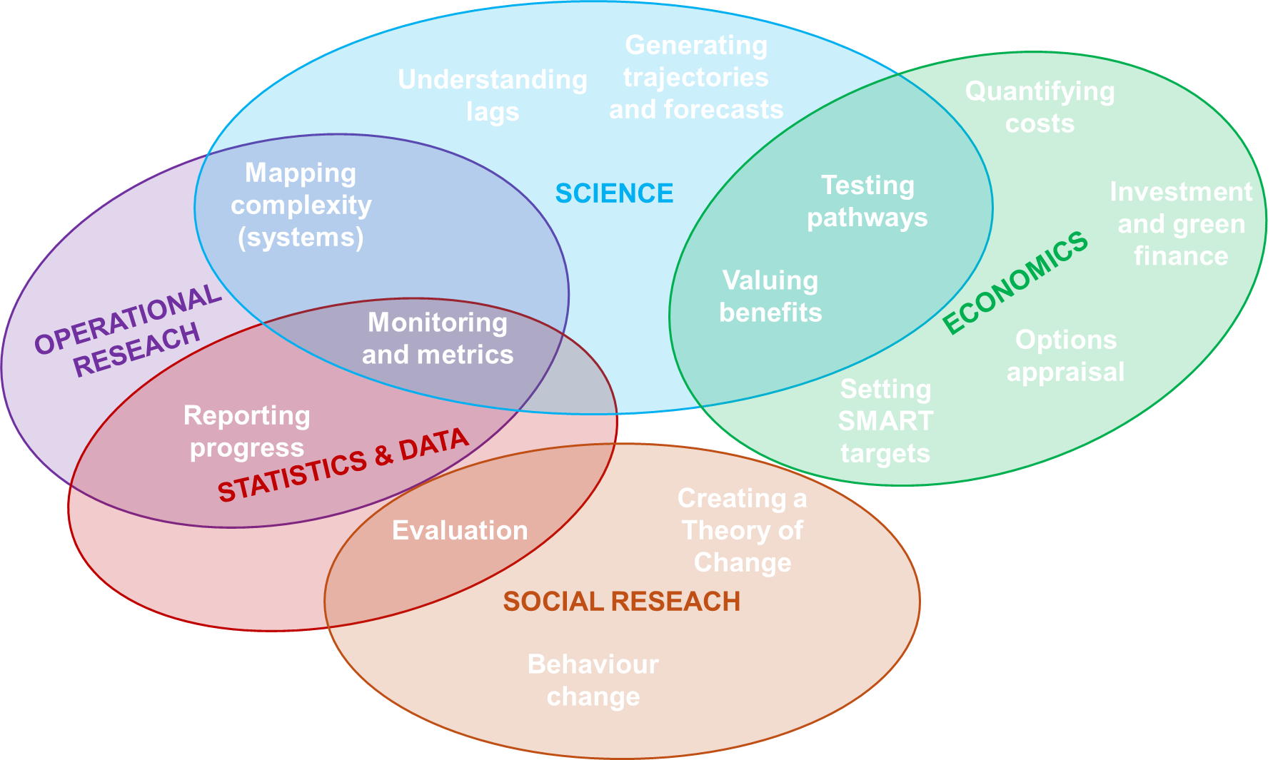
The role of our evidence professions

Slide 6
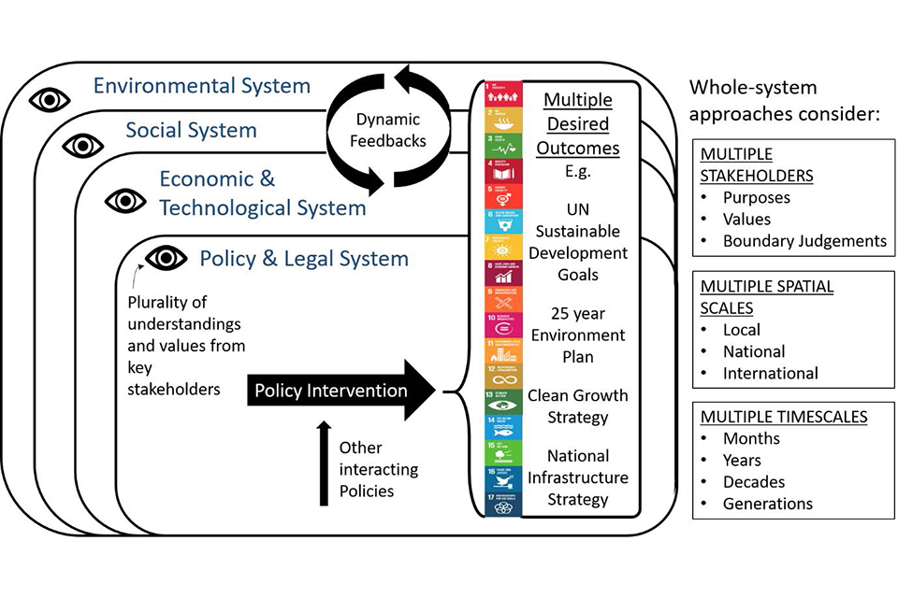
Defra’s Systems Research Programme
Set up in 2019, it has:
Introduced a standardised approach to applying systems thinking in Defra (published on GOV.UK in May 2022)
Developed tools and a community of practice to work across science-policy interface

Slide 7
Land use choices
Biodiversity
& wildlife
Only way to get what we need is via multi-functionality of land use
Spatial targeting can increase the amount and the value of derived benefits and co-benefits
Integrated spatial modelling used to find optimised state and set targets
Food and
resources
Amenity/
social value
Pollution
Mitigation/C Sequestration
Housing &
businesses

Slide 8
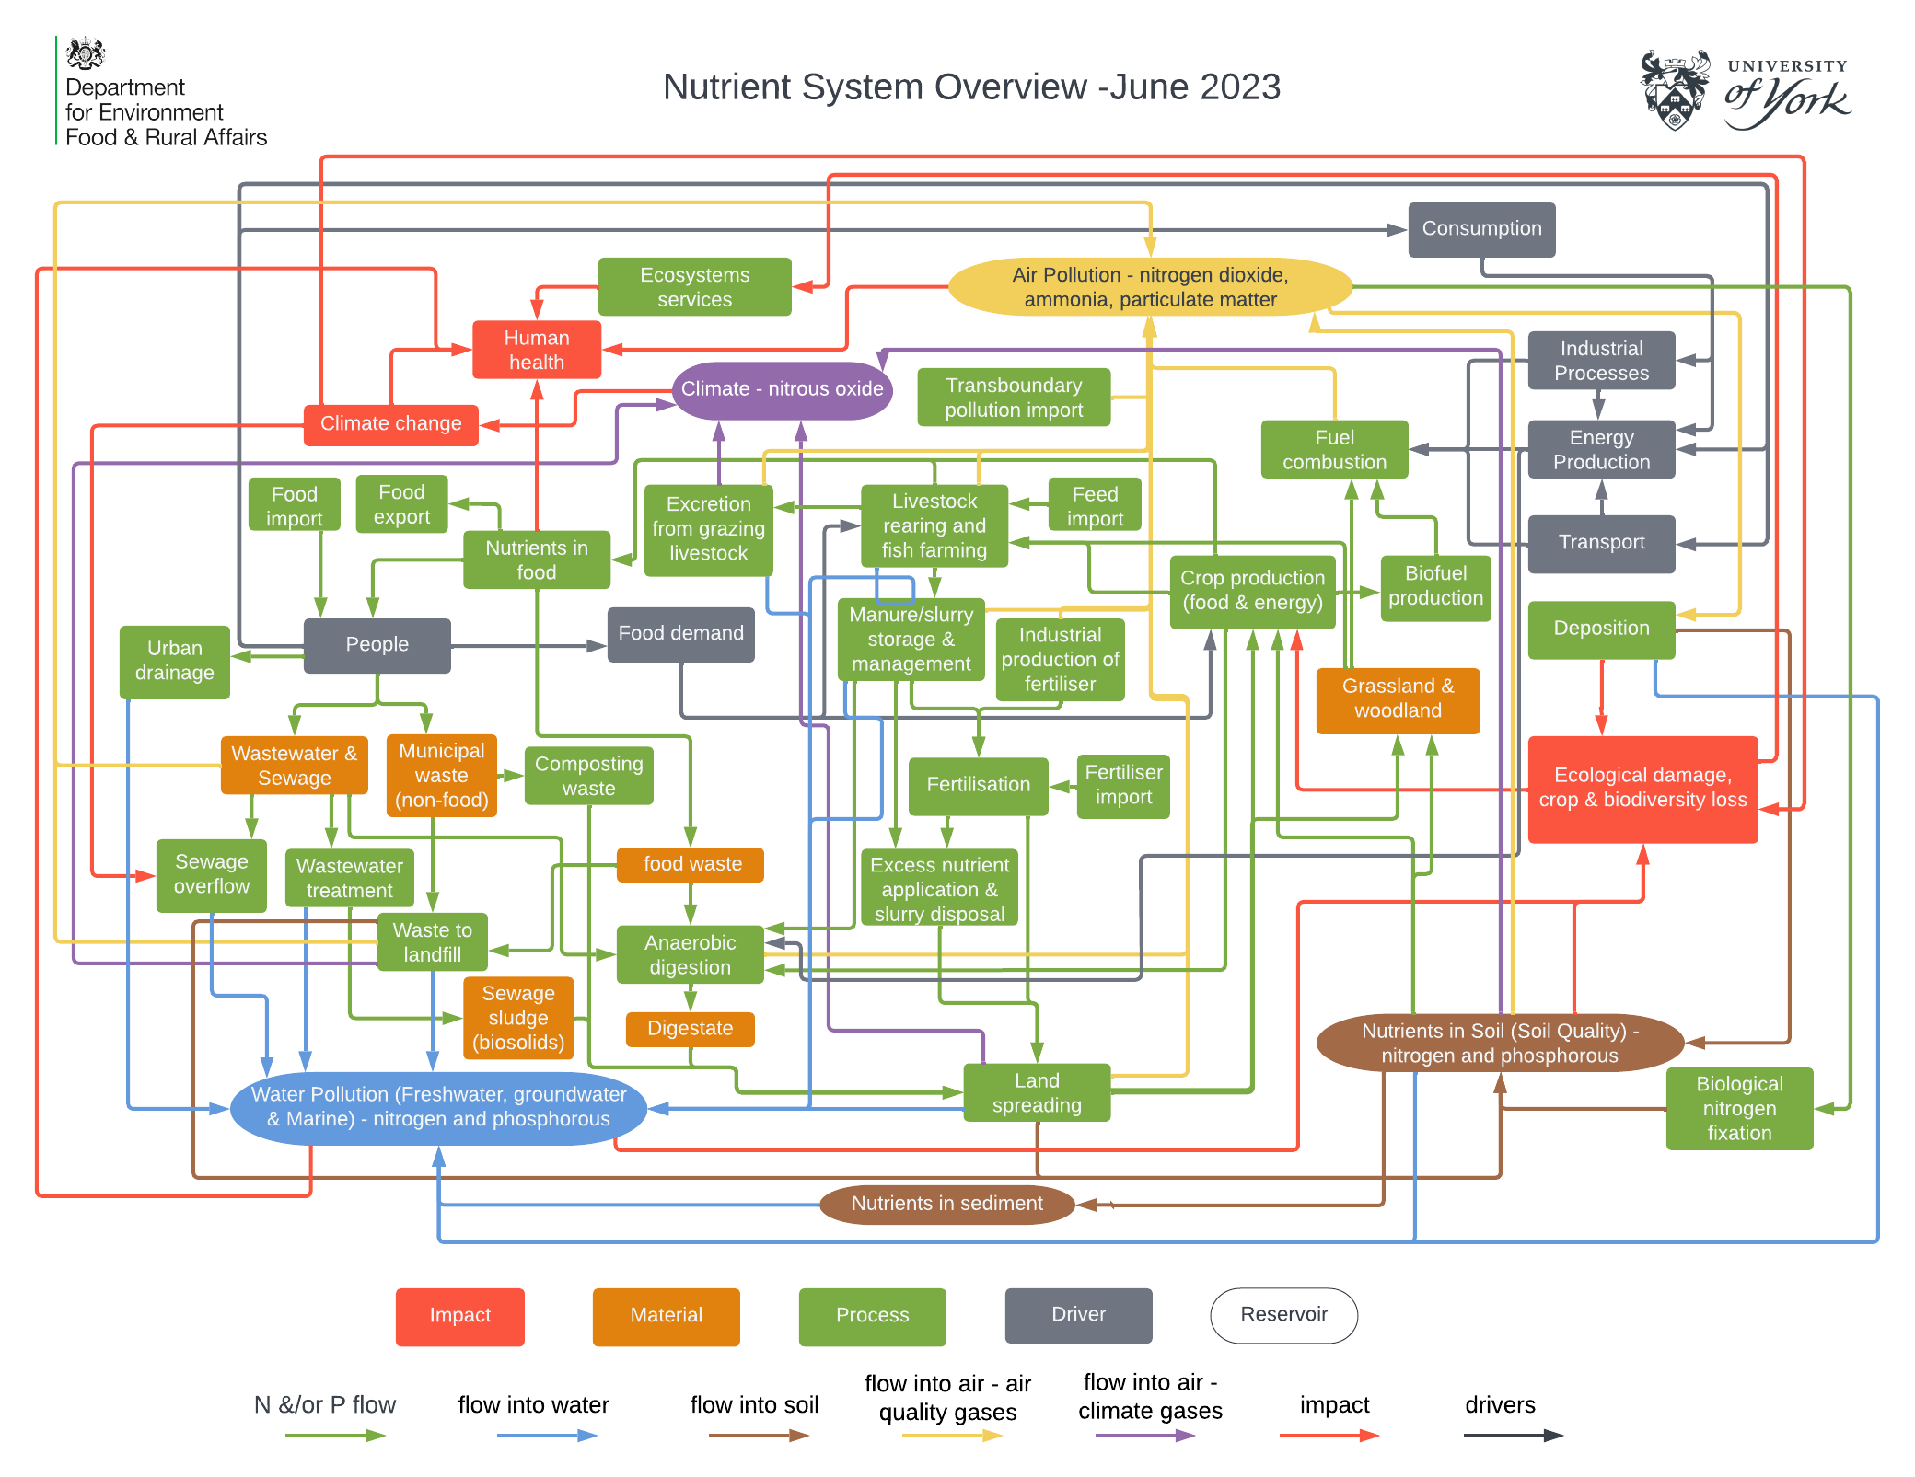
The nutrient system
Developed by Dr Sarah Moller, a NERC funded KE and Systems Fellow
Visualisation of key drivers, reservoirs, flows and impacts of the nutrients nitrogen and phosphorous in the UK. This visualisation is not intended to be exhaustive.

Slide 9
The urban water environment &
future of wastewater management
Needs a systems approach to:
Maximise benefits across outcomes (env/soc/econ)
Reduce process emissions of greenhouse gases
Minimise costs (not just £, also carbon & other)
Consider impacts on urban and transport run-off
Build in circular economy and resource recover/generation
Cope with increasing population and climate change
Link with biomass strategy and future use of sludge

Slide 10
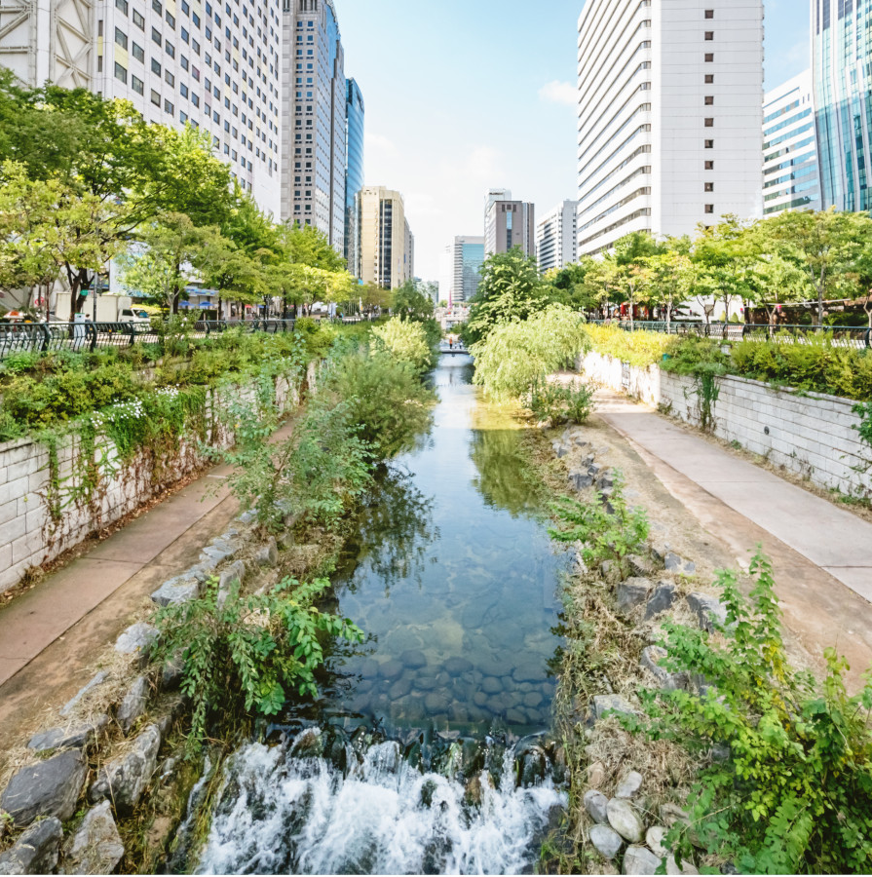
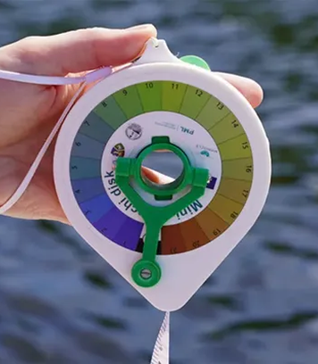
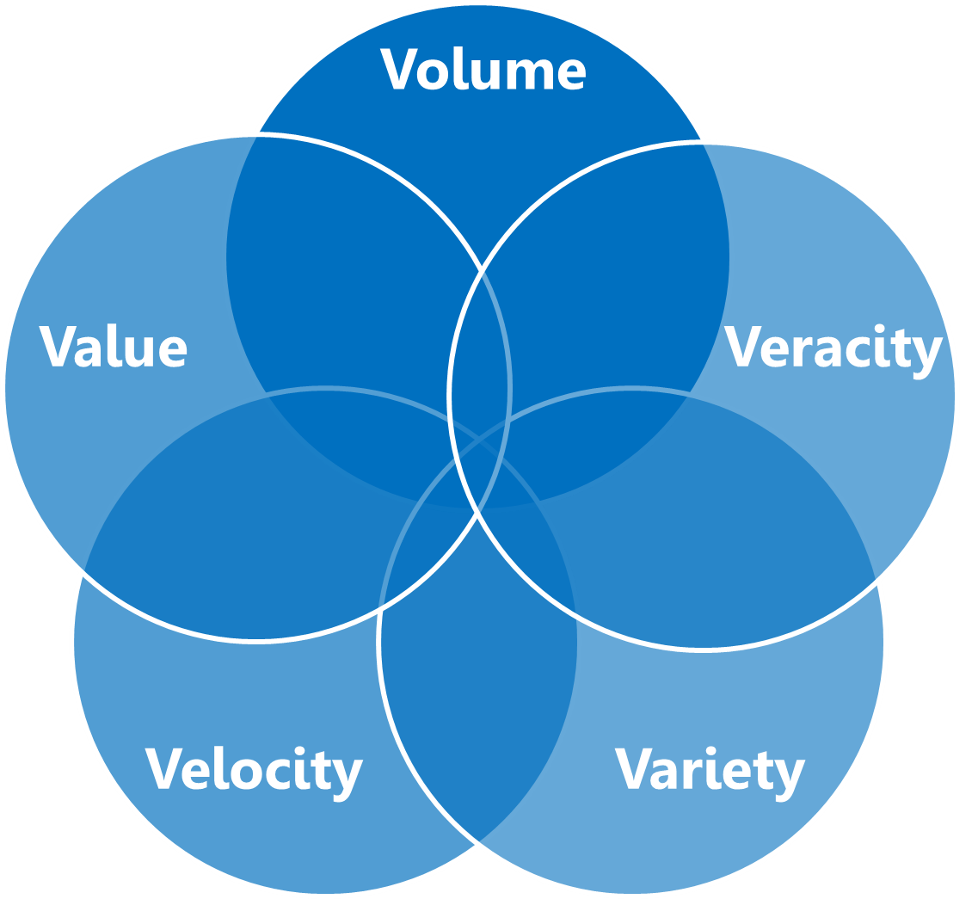
The future for water management
Data – both a challenge and an opportunity
A growth in urban blue spaces
Local decision making and citizens science

